Slide 1
ENGI 301 Game Machine Proposal
October 3, 2018
Francisco Montano

Slide 2
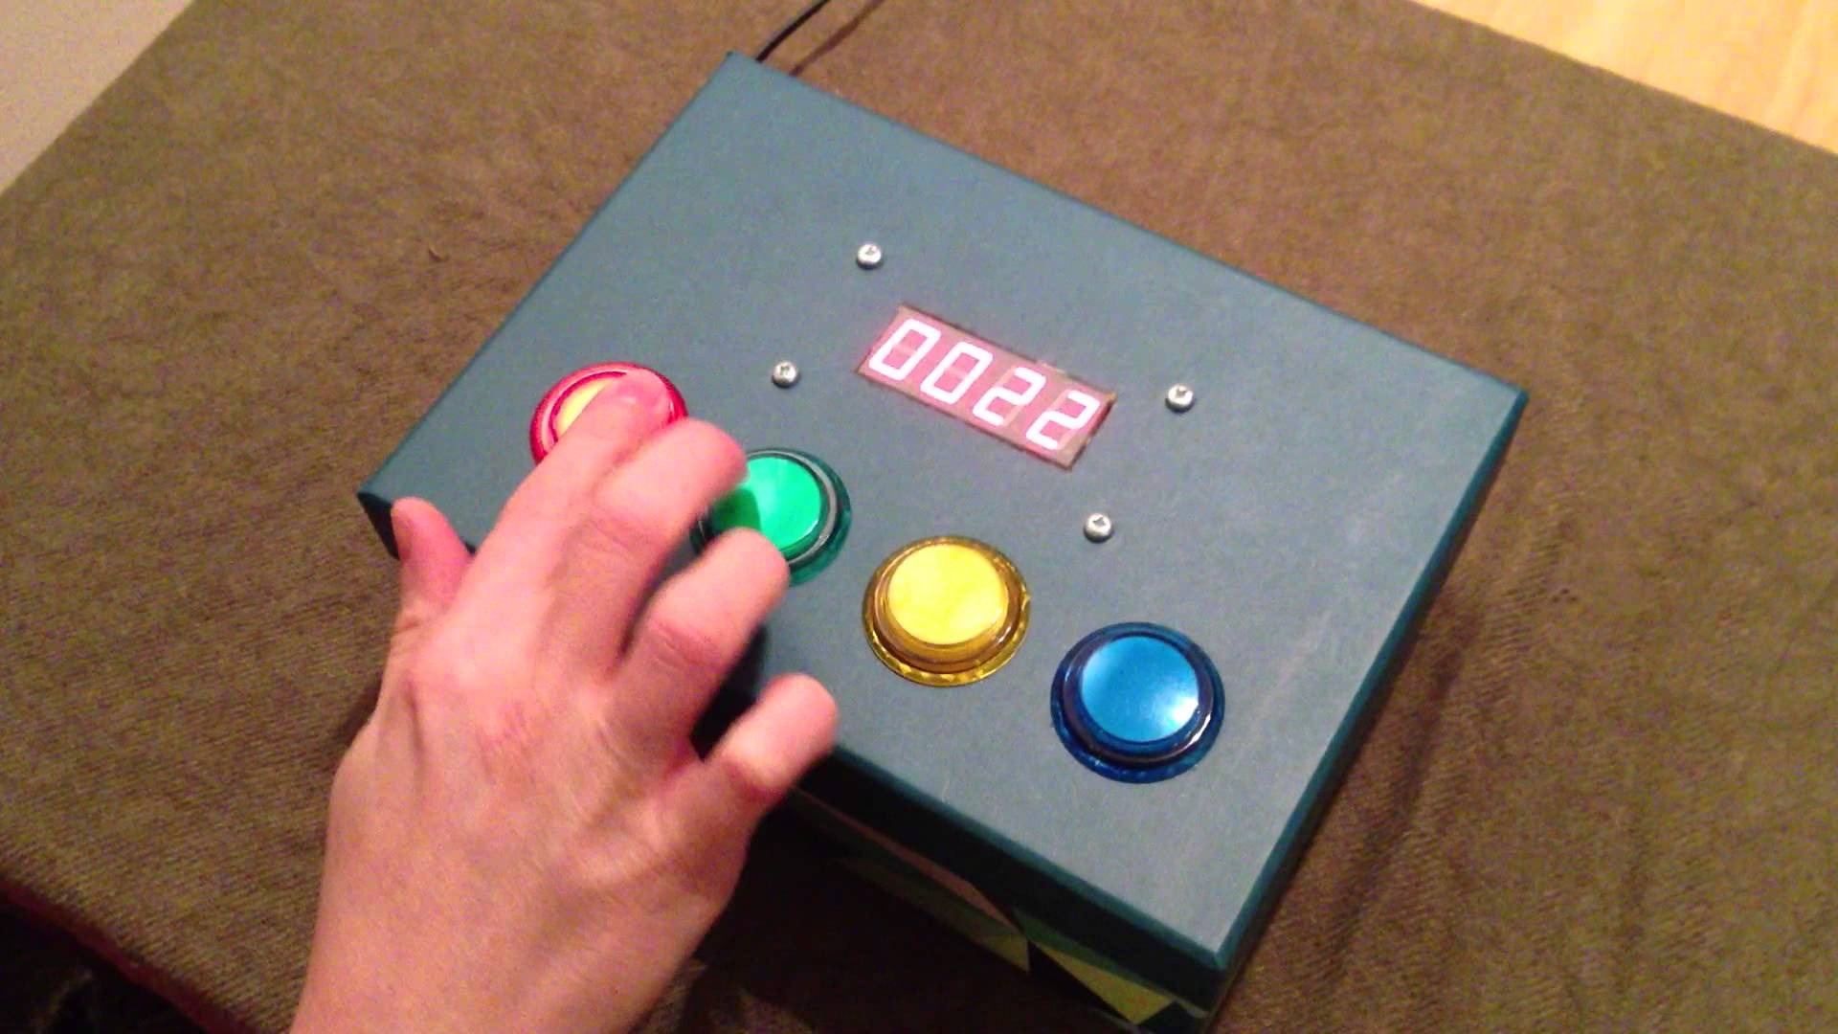
Background Information
Game Machine comes with two “games” programed:
Reflex/Reaction Time Tester
Measures your reaction time when exposed to stimuli, usually lights or sound.
Simon Says
Tests user’s memory by having them press buttons in the correct order
Here is an example of an Arduino-based reflex tester
My project would consist of
4 light-up buttons
1 Buzzer to provide sound-based stimuli
1 Display to show latest reaction time in millisecons

Slide 3
System Block Diagram
Adafruit Display
P2.9
P2.11
P2.13
PocketBeagle
5V
GND
P2.1
P2.2
P2.4
P2.6
P2.8
P2.18
P2.20
P2.22
P2.24
Transistor
Transistor
Transistor
Buzzer
Transistor
LED/Button
LED/Button
LED/Button
LED/Button

Slide 4
Power Block Diagram
PocketBeagle
Buzzer
Buzzer
Display
3.3V
USB Power
5V
Buttons
5V

Slide 5
Components / Budget
Component | Need to Buy | Cost
PocketBeagle | --- | ---
Generic Breadboard | --- | ---
Generic Buzzer | --- | ---
Generic Wires | --- | ---
Generic Transistors | x4 | *
Resistor (1k Ohm) | x2 | *
Adafruit Display | --- | ---
Arcade Buttons | x1 | $8
* Available at ELEC Lab

